Slide 1
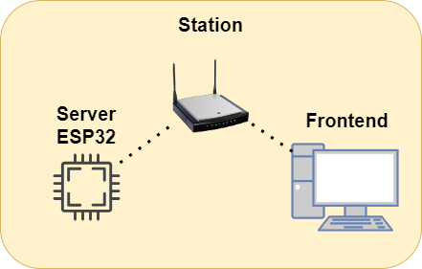
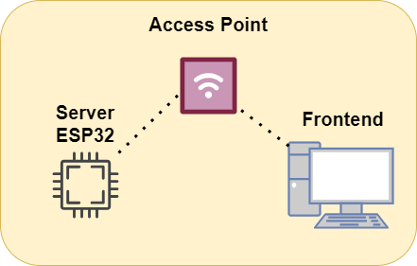
Proxi ESP32
Install Node.js
Esp32 server, REST API
npx http-server ./web -P (http://192.168.4.1)
npx http-server ./(frontend) -P (http://ip_esp32)
Access point or Station

Slide 2
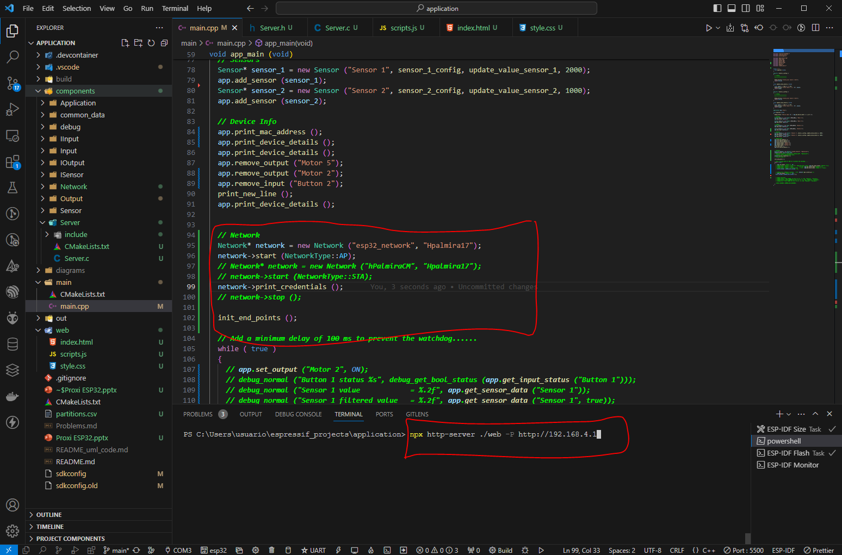
Proxi ESP32

Slide 3
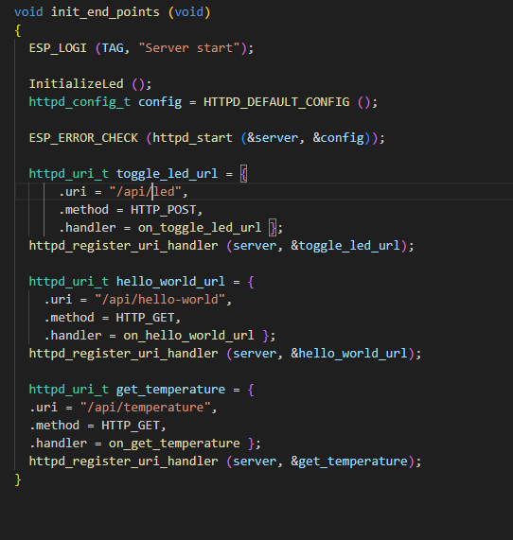
Endpoints ESP32

